Slide 1
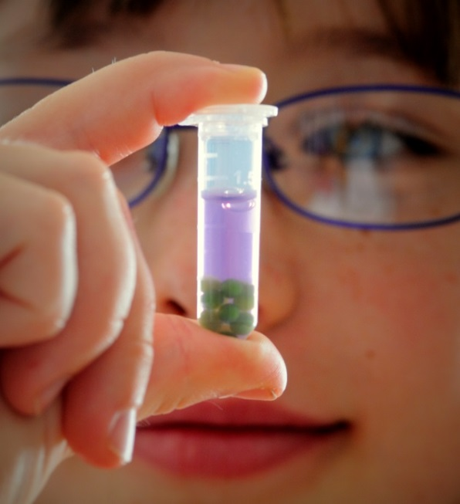
Investigate Photosynthesis and Cellular Respiration with Algae Beads for GenBio
Bio-Rad Explorer
Photosynthesis and Cellular Respiration Kit for General Biology

Slide 2
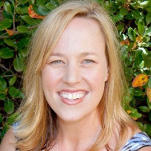
Curriculum & Training Specialists
Damon Tighe
Leigh Brown
Tamica Stubbs
bio-rad_explorer@bio-rad.com

Slide 3
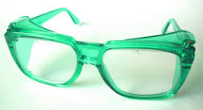
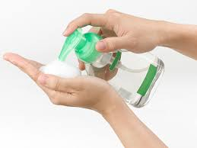
Safety First!
Protective equipment is provided for your use
Goggles
Gloves (non-latex)
Hand sanitizer / hand wipes are available for use after lab activities
Do not eat any food items used in lab activities
An eye wash station is provided in the workshop room.
At the end of the workshop, please return goggles to the collection area in the back of the room. Thank you!

Slide 4
Today you get think like a student…
Photosynthesis & Cellular Respiration
https://upload.wikimedia.org/wikipedia/commons/0/00/Empty-classroom.jpg

Slide 5
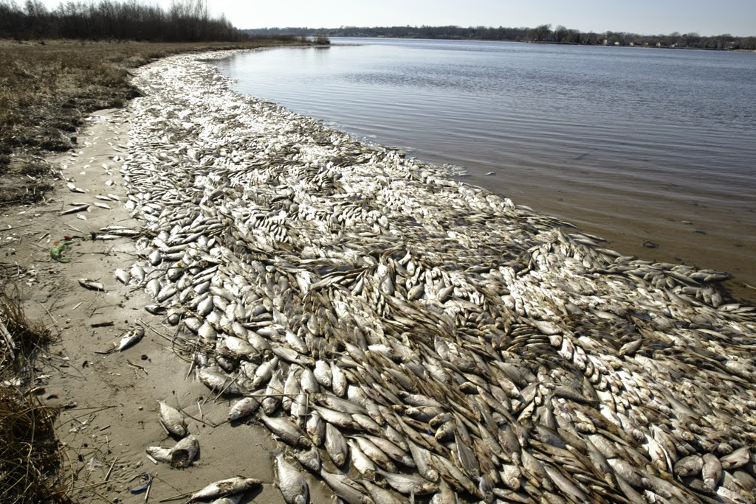
Phenomenon – mass die offs of fish

Slide 6
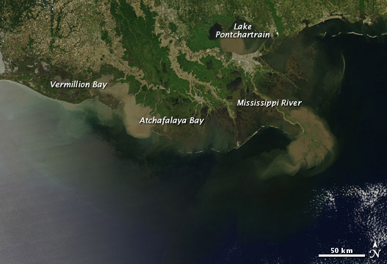
Phenomenon – Satellite image of area
What do you notice?
Source: NASA

Slide 7
Classroom Context & Inquiry: Dead Zone of the Gulf of Mexico
What
Causes the Dead
Zone?

Slide 8
Workshop Outcomes
How can you use immobilized algae cells to demonstrate the capture of CO₂ from the environment during photosynthesis and the release of CO₂ into the environment during cellular respiration?
How can you take quantitative and qualitative measurements of photosynthesis and cellular respiration rates, to illustrate CO₂ movement?
How can you engage students in an authentic inquiry activity that applies concepts relating to photosynthesis and cellular respiration into one lab?

Slide 9
What could that liquid be?
Note the initial color of the liquid in the cup.
Use the straw to gently blow into the liquid for about 5 seconds.
In groups, discuss any changes you observed.
?
Notes:
Observation-> What do you think causes the change? -> Directly measures? -> Indirectly measures?
How can we use this indicator solution to open the door to student questioning the relationship between PS & CR?

Slide 10
Observations
What did you observe?
Color changed from red (or red-orange) to yellow!
?
Notes:
Observation-> What do you think causes the change? -> Directly measures? -> Indirectly measures?
How can we use this indicator solution to open the door to student questioning the relationship between PS & CR?

Slide 11
Think like your students…
How many of your students will remember that plants do BOTH photosynthesis and cellular respiration?
Do they understand how PS and CR are connected?

Slide 12
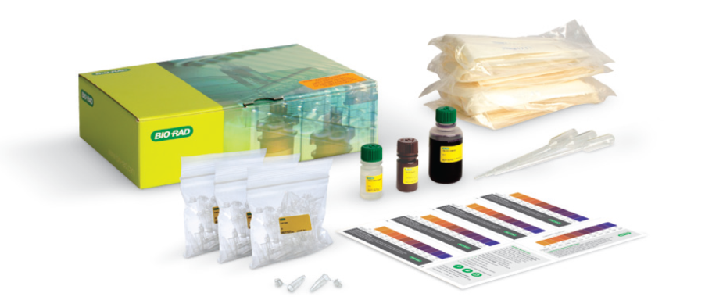
Our Photosynthesis & Cellular Respiration Kit helps to bridge the connection!
Kit Design: Applicable to Biology (Gen Bio -AP) and Environmental Sciences with a teaching emphasis on inquiry-based experiments.
Algae Beads: Live algae (Scenedesmus obliquus) are immobilized in alginate as “beads”. The algae can photosynthesize and respire while beaded.
CO₂ Indicator: Colorimetric pH indicator allows for qualitative and quantitative data collection.

Slide 13
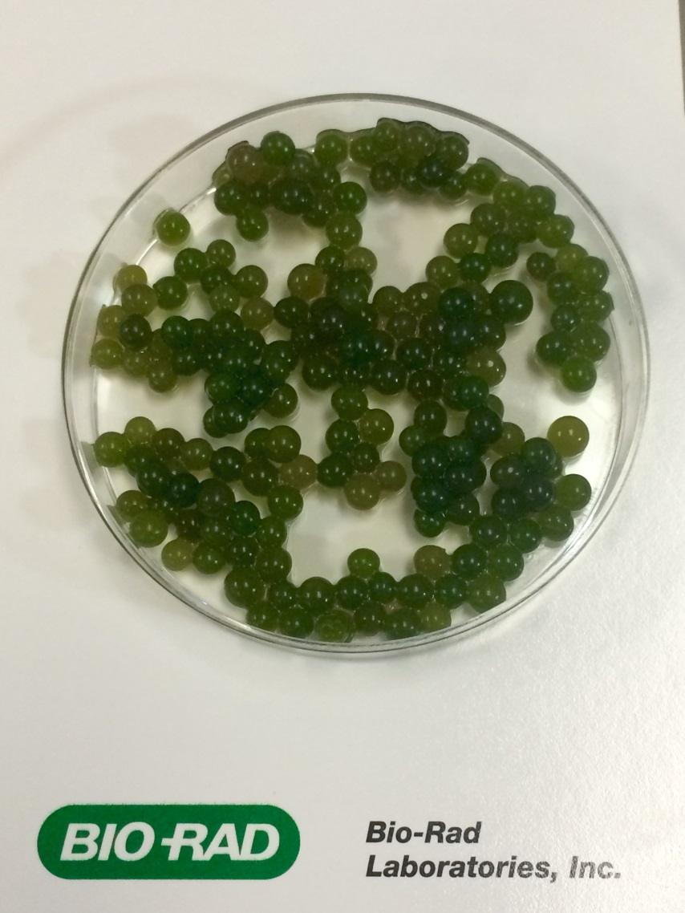
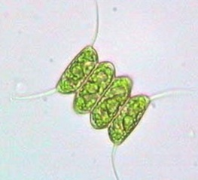
Algae Beads are AWESOME!
Beads are easy for students to handle and move
Algae can be reused for multiple
Experiments
Algae beads have more then a month
shelf life and require minimal prep
Algae beads
(~ 2 mm)
Algae beads are easy to dispose

Slide 14
CO₂ Indicator – how does it work?
CO₂ combines with water to make carbonic acid (H₂CO₃).
More CO₂ = more carbonic acid = pH = more
?
?
Higher / lower?
Yellow / purple?
CO₂ in solution

Slide 15
CO₂ (pH) Indicator
CO₂ combines with water to make carbonic acid (H₂CO₃).
MORE CO₂ = more carbonic acid = LOWER pH = more YELLOW
CO₂ in solution

Slide 16
CO₂ (pH) Indicator
CO₂ combines with water to make carbonic acid (H₂CO₃).
What happens when we have LESS CO₂?
CO₂ in solution

Slide 17
CO₂ (pH) Indicator
CO₂ combines with water to make carbonic acid (H₂CO₃).
LESS CO₂ = less carbonic acid = HIGHER pH = more PURPLE
CO₂ in solution

Slide 18
Putting it all together
Dark
cellular respiration (CO₂ production)
pH decreases
yellow
Light
photosynthesis (CO₂ consumption)
pH increases
purple
CO₂ in solution

Slide 19
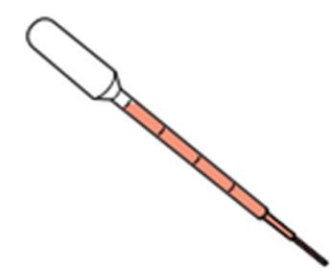
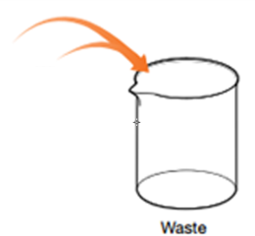
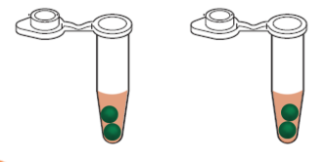
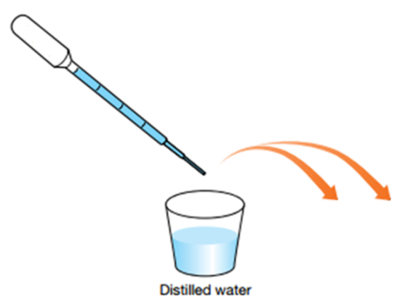
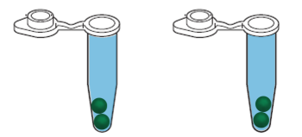
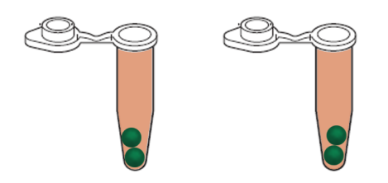
Procedure
Use a disposable pipet to remove as much liquid as possible from both tubes. Put liquid in waste cup.
Using the same pipet, fill up each tube with distilled water to rinse the algae beads. Let sit for 5 minutes.
Remove the distilled water, and fill each tube with fresh liquid.

Slide 20
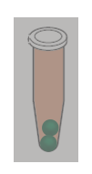
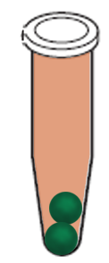
Procedure
Close lids. Wrap one tube in aluminum foil. Leave the other tube uncovered.
Put both tubes on their side, a couple of inches from a light source. You can use your cell phone flash light or the light provided.
Make observations every 5 min, compare against color standard
foil-covered

Slide 21
Lab Summary - Workflow

Slide 22
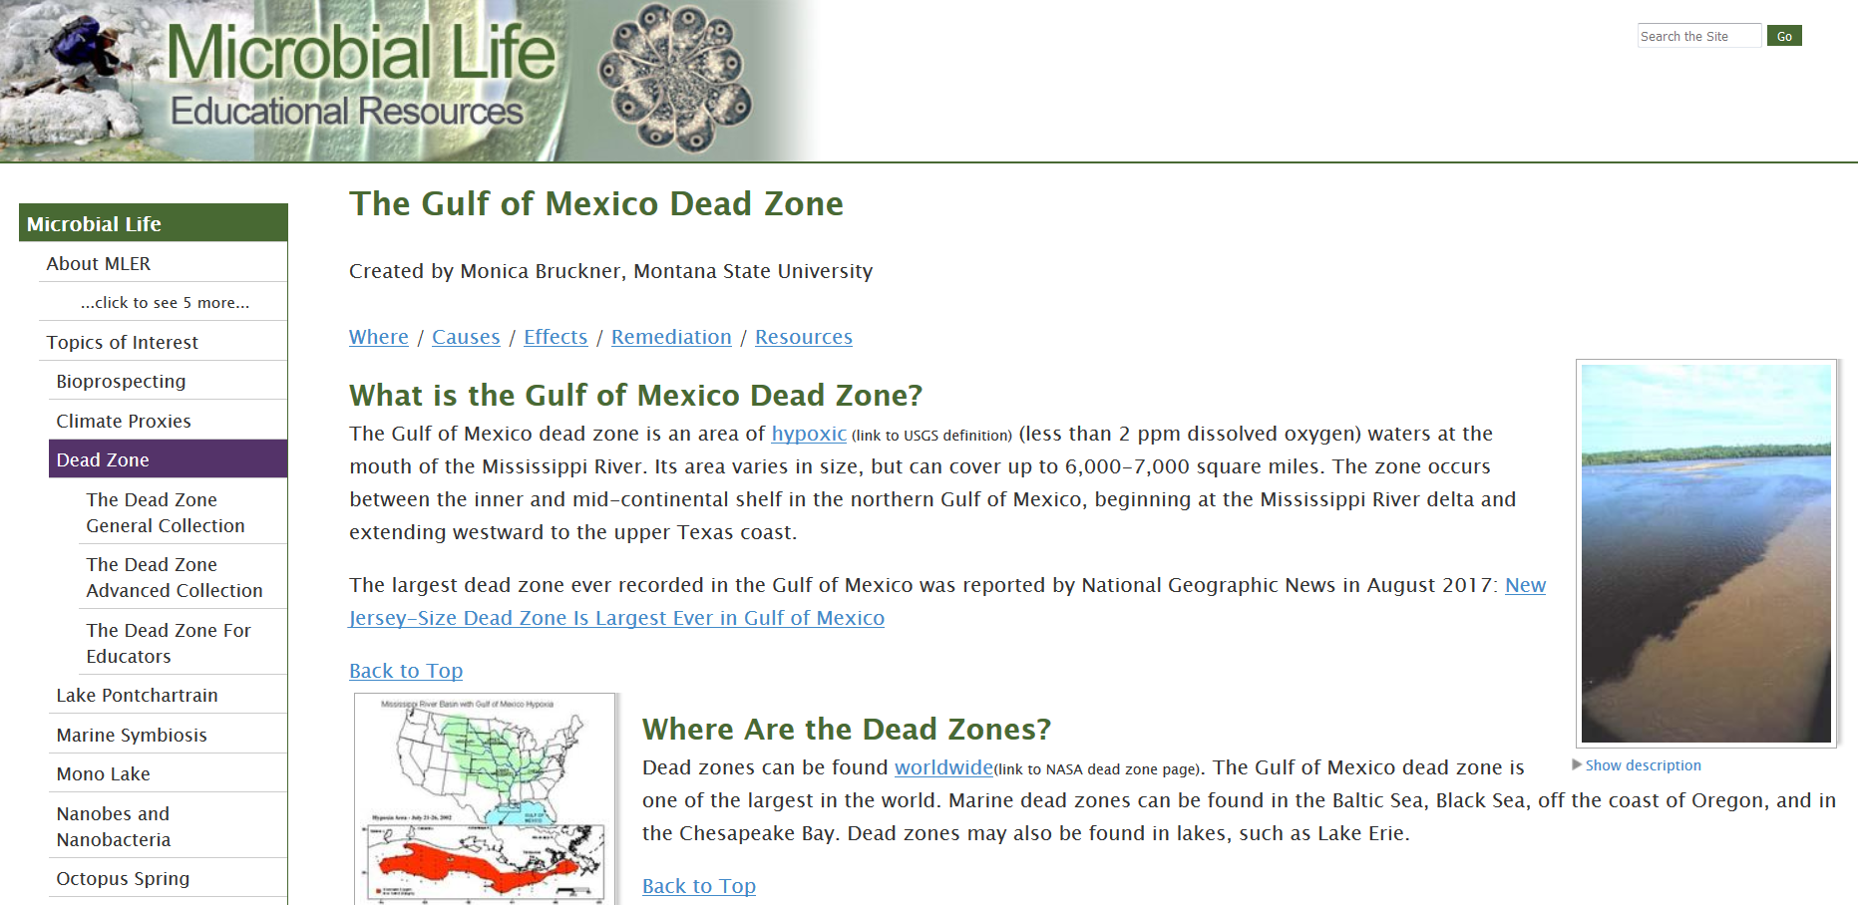
Gulf of Mexico Dead Zone Resources
https://serc.carleton.edu/microbelife/topics/deadzone/index.html

Slide 23
ThINQ!™ Resource Page
bio-rad.com/ws/ThINQresources
Get teaching resources:
videos
case studies
class activities

Slide 24
Full Kit: 17001238EDU $145 Explorer Catalog pg. 12 Refill Kit: 12002353EDU debeading solution, indicator, and beads $119
Photosynthesis & Cellular Respiration Kit
bio-rad.com/algae

Slide 25
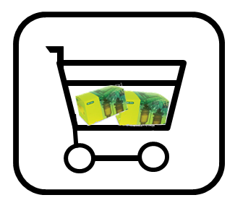
How to Buy

